Slide 1

Problem Solving Using Computer
Course Code: BCAC 0018
Lecture – 17&18
Course: BCA I Year I Semester
By: Mr. Shivank Chauhan
shivank.chauhan@gla.ac.in
+91-9694159338

Slide 2
Structure of Python Program
The typical structure of a python program include 3 parts:
Import statements // import statements are used to include library files to the python program
Function definitions //This section include the definitions of various functions written in a Python Program
Program statements // This section include the set of statements for solving the given problem.

Slide 3
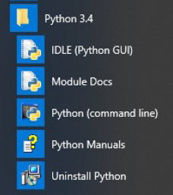
Elements of Python
Python has 4 components:
1. IDLE (Python GUI): It is a cross platform GUI Integrated Development Environmental that is provided with Python for editing and running a Python programs. It is a bundled set of software’s tools such as Python Shell for Scripting programs and text editor for creating and modifying Python’s source code, a debugger for finding error, help system etc.

Slide 4
2. Module Docs: This component allows us to access the python documents such as build in modules, DLLs, libraries, packages etc.
3. Python (Command line): Python can also be access from the command line. Command line mode provide very less features in comparison to IDLE but it is fast.
4. Python Manual: This component include various documents related to Python such as: installation cum setup guide, tutorials, Python API , FAQs etc.

Slide 5
Python IDE
Python IDE (Integrated Development Environment) understands the code significantly better than a text editor. It is a program exclusively built for software development. It is designed with a set of tools that all work together:
Text editor
Compiler
Debugging
Build automation
Libraries, and many more to speed up the work.

Slide 6
Different Python IDEs
Python is a programming language with many different IDEs available.
Each IDE has its unique features and benefits.
Some popular IDEs are listed below:
IDLE
PyCharm
Visual Studio Code
Sublime Text 3
Atom
Jupyter
Spyder
PyDev
Thonny
Wing

Slide 7
Selection of right Python IDE
Requirements vary from programmer to programmer.
It is one’s own choice to pick the right tool that is best suited for the task at hand.
Beginners need to use a simple tool with few customizations, whereas experts require tools with advanced features to bring new updates.
A few suggestions are given next:

Slide 8
1. Depending on Expertise:
Beginners should start with IDLE and Thonny as they do not have complex features and are pretty easy to learn.
Intermediate: PyCharm, VS Code, Atom, and Sublime Text 3 are solid solutions for intermediate users.
For data science learners, Jupyter Notebooks and Google Colaboratory are preferred.
2. Depending on Objective:
Data Science: Spyder, Jupyter Notebook, and PyCharm Pro (Paid)
Web Development: Visual Studio Code and PyCharm Pro (Paid)
Scripting: Atom, PyDev, Sublime Text 3, and PyCharm (Free)

Slide 9
Python Interpreter
Python is a high level language.
Computer understand only machine language or binary language which is also known as low level language.
The job is to translate programming code written in high level language to low level language.
This can be done with the help of two type of software: Compiler and Interpreter.
Python is an interpreted language, which means the source code of a Python program is converted into byte-code that is then executed by the Python Virtual Machine.

Slide 10
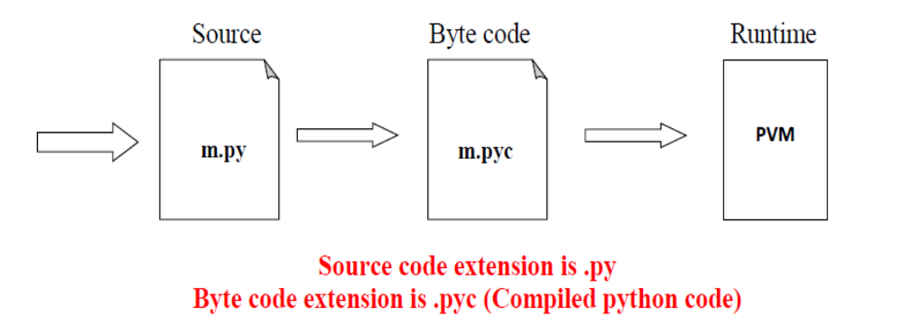
Python Code Execution
Source code you type is translated to byte code, which is then run by the Python Virtual Machine (PVM). Your code is automatically compiled, but then it is interpreted.

Slide 11
Python interpreter performs the following steps to execute a Python program or run a set of instruction in interactive mode:
Step-1: The interpreter read a Python code or instruction. Then it verifies that the instruction is well formatted, i.e. it checks the syntax of each line. If it encounters any error, it immediately halts the translation and shows an error message.
Step-2: If there is no error, i.e. if the Python instruction or code is well formatted then the interpreter translates it into its equivalent form in low language called ‘Byte Code’. Thus, after successful execution of Python script or code, it is completely translated into byte code.
Step-3: Byte code is sent to the Python Virtual Machine (PVM). Here again the byte code is executed on PVM. If an error occurs during this execution then the execution is halted with an error message.

Slide 12
Python as a Calculator
Python can be used as a calculator to compute arithmetic operations like addition, subtraction, multiplication and division.
Python can be used as a calculator to make simple arithmetic calculations.
Simple arithmetic calculations can be completed at the Python Prompt.
The Python REPL shows three arrow symbols >>> followed by a blinking cursor. Programmers type commands at the >>> prompt then hit [ENTER] to see the results.
>>> 5 + 3
>>> 8

Slide 13
Python Shell
Python Shell is the command line interpreter that executes your Python programs, other pieces of Python code, or simple commands.
A command line, also known as a command prompt, is a type of interface.
Python has two basic modes: script and interactive.
Interactive mode is a command line shell which gives immediate feedback for each statement, while running previously fed statements in active memory.

Slide 14
Indentation
Indentation in Python refers to the (spaces and tabs) that are used at the beginning of a statement. The
statements with the same indentation belong to the same group.
For Example
a=2
print(a)
if a==3 :
print(“hello world”)
else :
print(“ bye world”)

